Slide 1
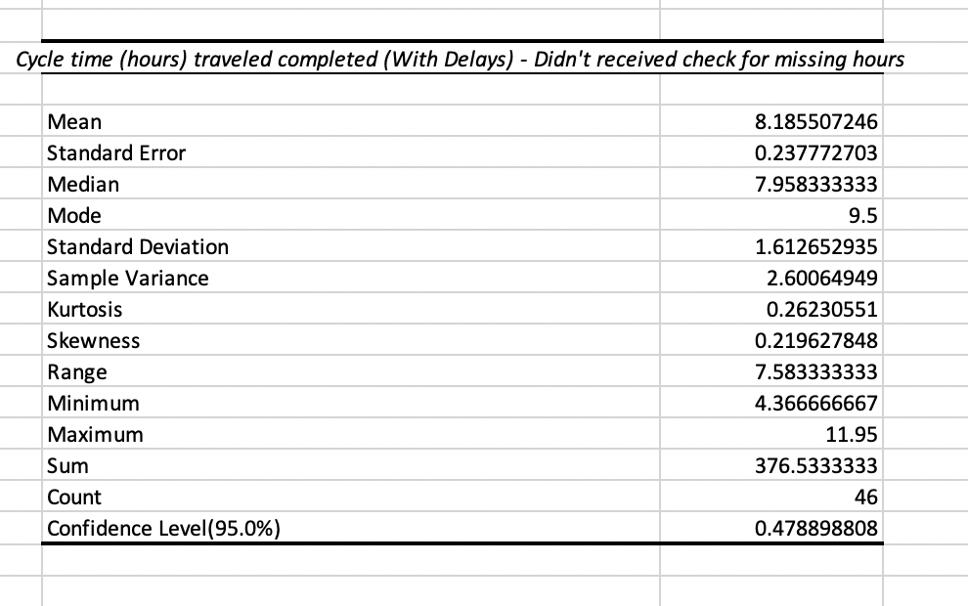
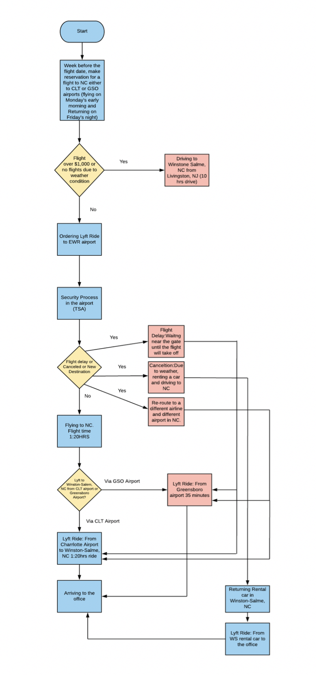
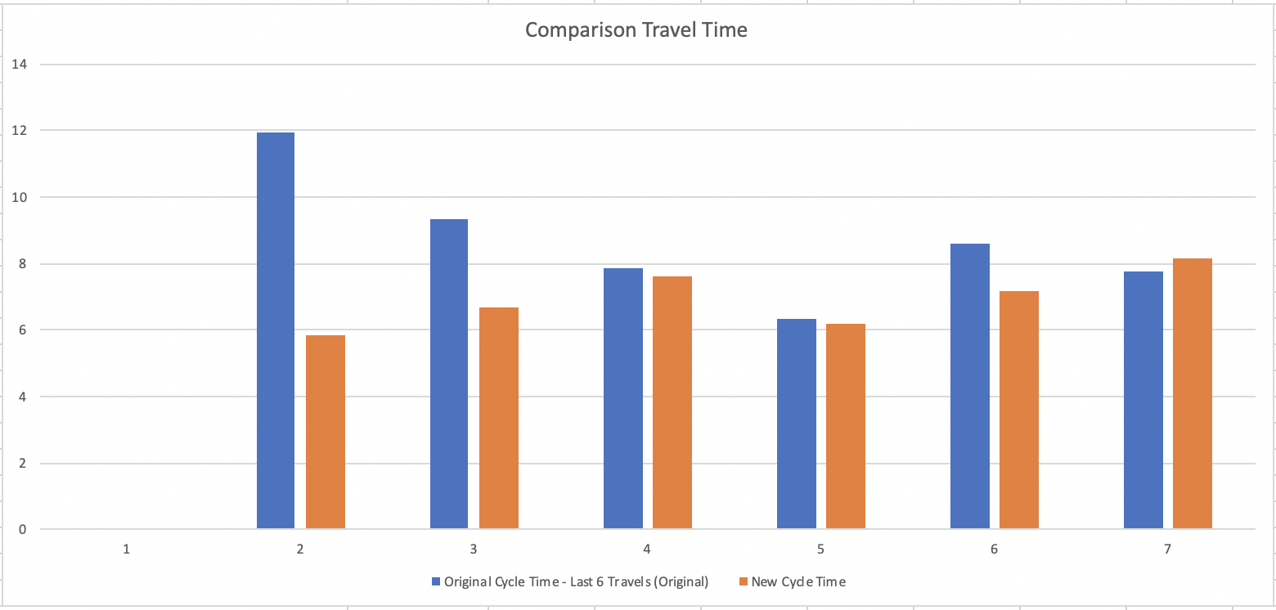
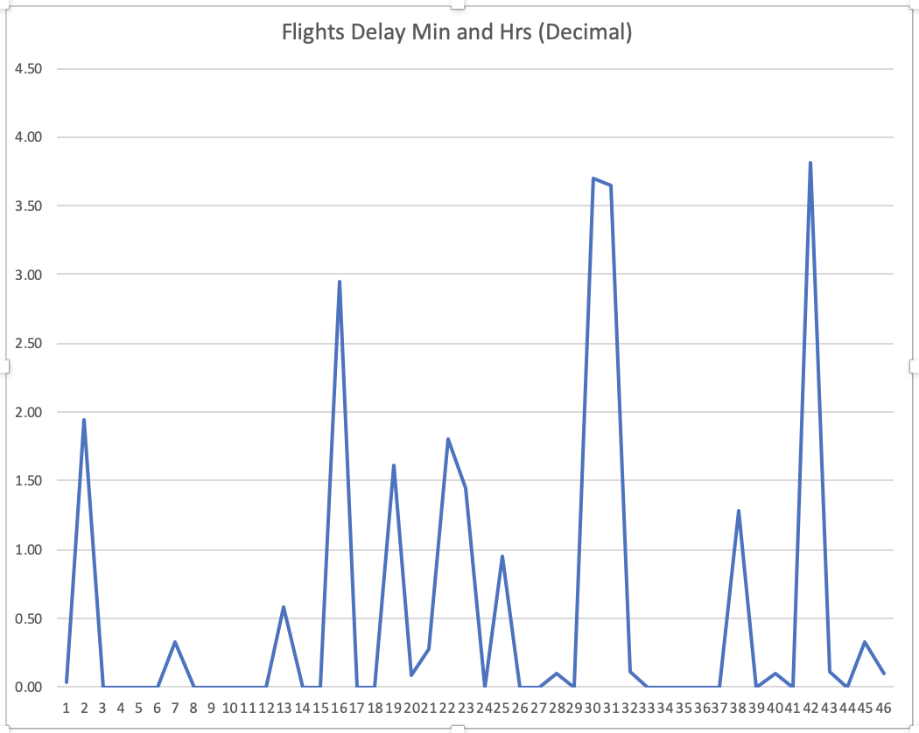
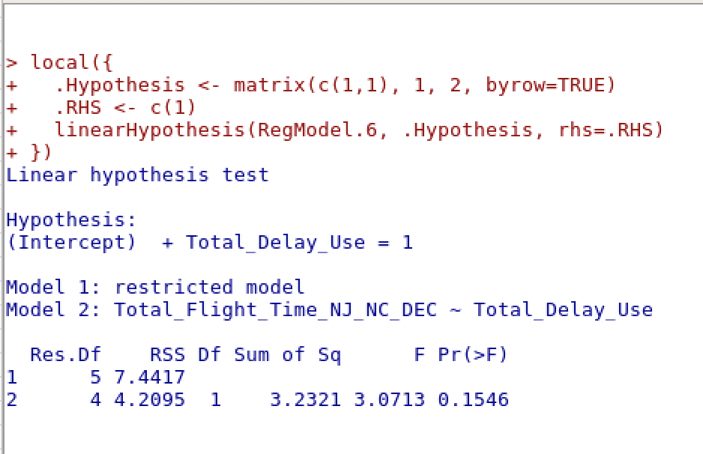
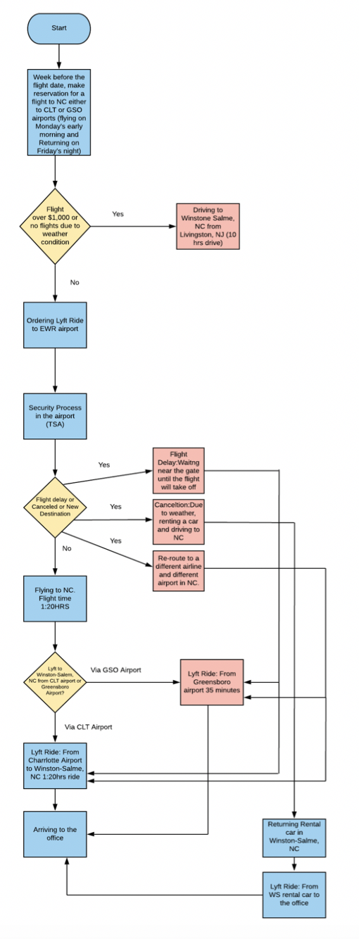
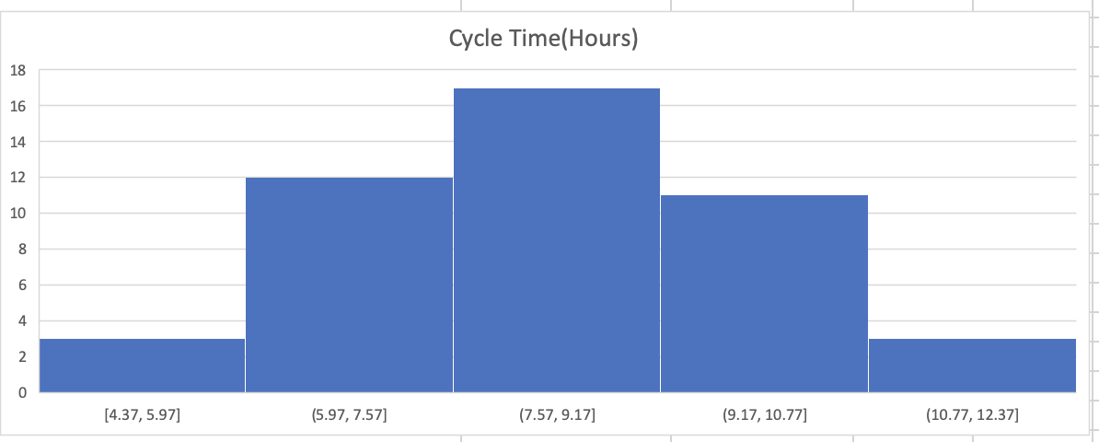
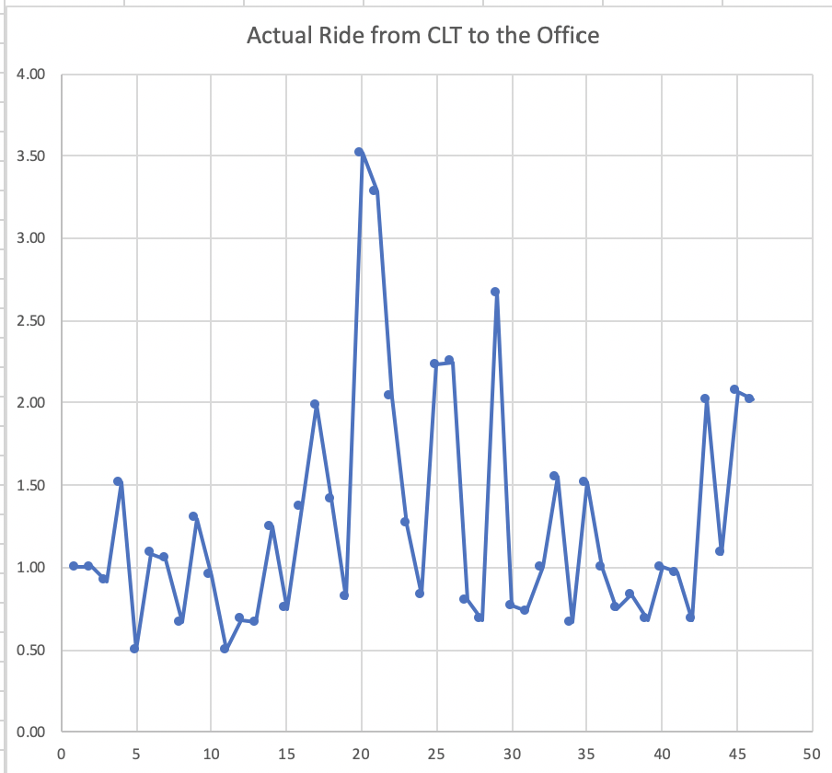
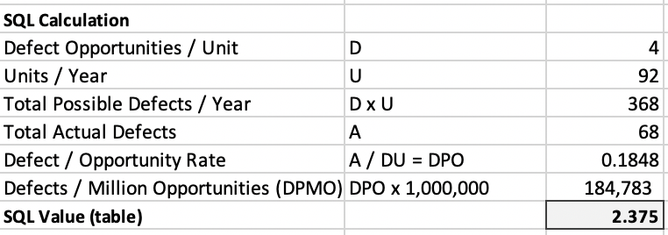
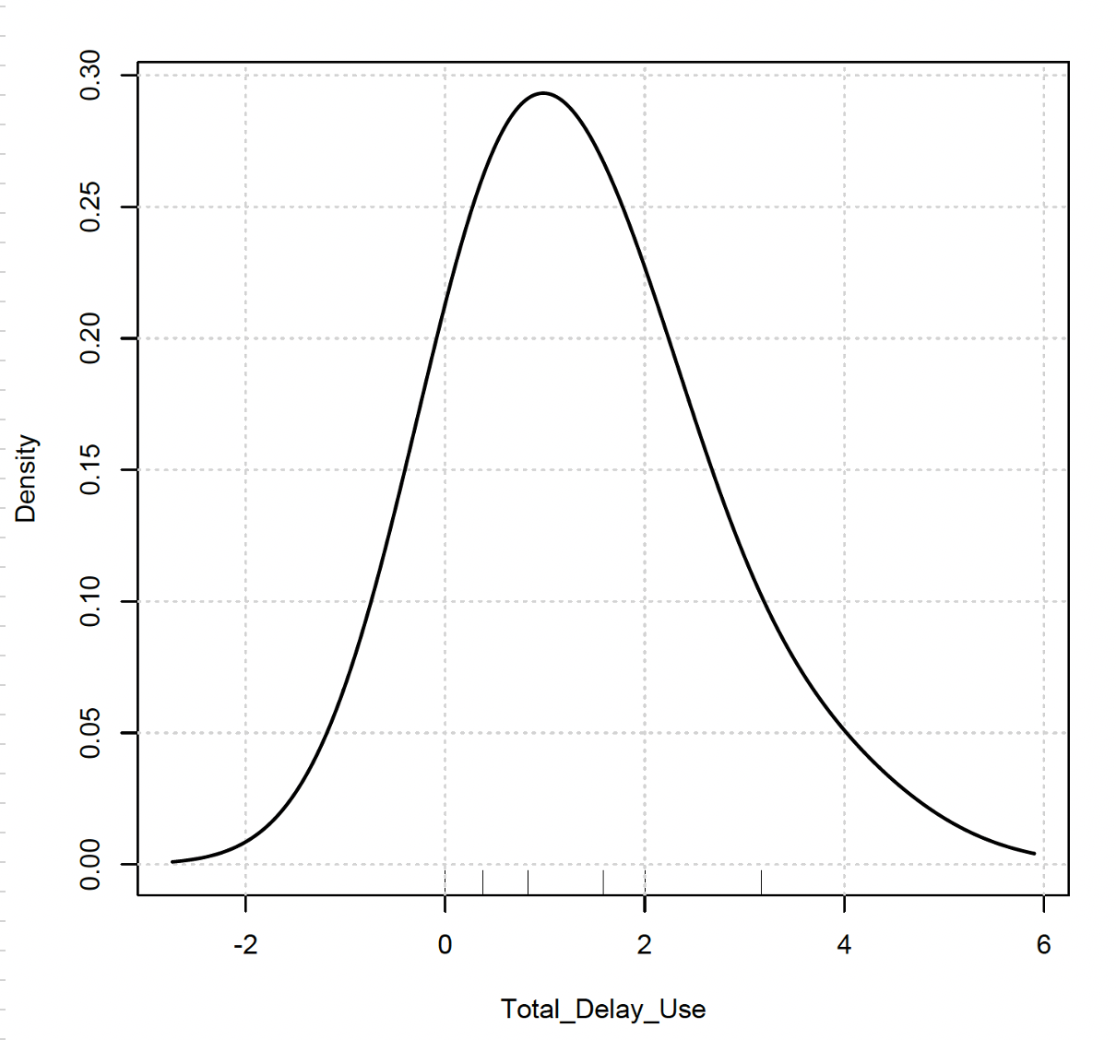
Process Improvement– Cycle Time: Livingston, NJ – Winston-Salem, NC
Improving Traveling Time/Earning USD due to Imp. Traveling Time
Process owner: Yehuda Perry
Define:
Proj. Launch:
Measure:
11/05/2018 – 12/08/2019
Analyze:
Improve:
Control:
October 8
October 12
November
09/24/2019 – 12/08/2019
10/30/2019
November 19
DEFINE
MEASURE
ANALYZE
IMPROVE
Problem Statement
Arriving late to work. Avg traveling time with delays
~3-4 hours on a weekly basis and Avg of ~16 hours per month, due to un-expected traveling delays from NJ to NC.
Leaving on Monday’s will cause most likely late arrival to the office
Late
Rides from CLT airport to the office, due to long drive, causing for delays
Business Impact
The average on Monday’s is ~ 12-16 hrs. per month., 4 hrs. avg per one Monday * 12 months with $350 per hour equal to: ~ $50,400 - $67,200 annually which I lose per year.
Improvement
Traveling Time
Spending ~ $ 400 more/Week since traveling on Sunday is expensive
$2,800/Week added to the weekly earning. (Used to have ½ of it or almost none with the entire delays
Traveling time reduced from ~ 8hrs to ~ 5.5hrs
Cost savings $67,200!!!
SQL raised from 2.3 to 3.3 and rising!
Loosing Money
Average Delay 8.18
High cycle time
SQL = 3.3
Hypothesis Test
Flights indicated there is relationship between delay to work and flights
Original Process Map
Density Total Delay
Longest Flight Delay 4 Hrs. and 13 Min.
CONTROL – Changes to be made
SQL = 2.3
Traveling Monday early morning is not an option anymore. Only Sunday’s afternoons.
Purchase flight tickets in advance for Sundays flights (30 days or more)
Appraisal rated on compliance
Actual Ride from CLT to the office
Business Case: Annually lost between $50.4K to $67.2K

